Slide 1
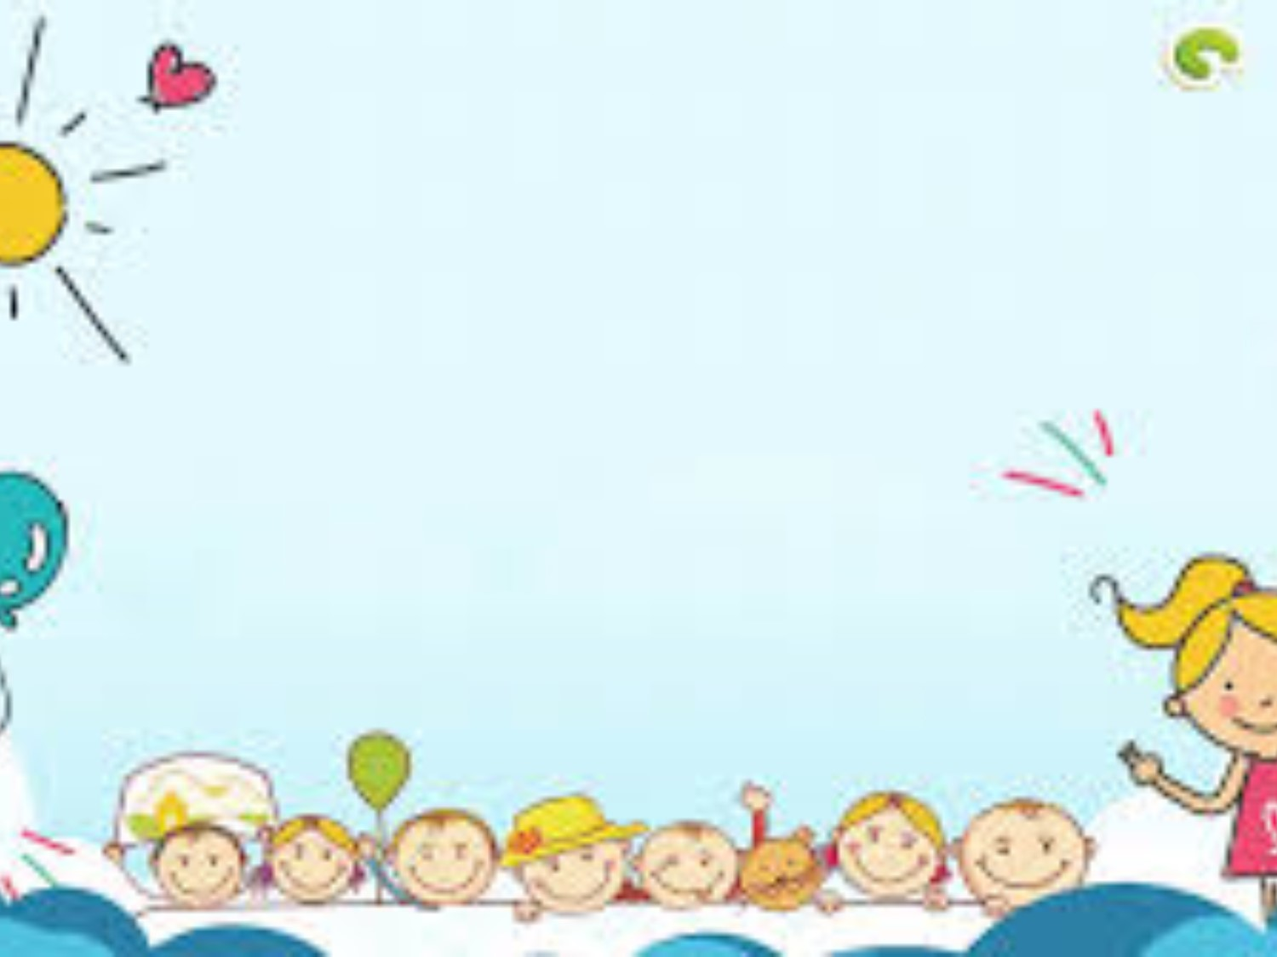
Unit 10: B1-3

Slide 2
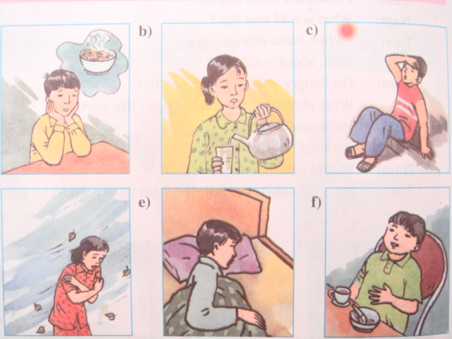
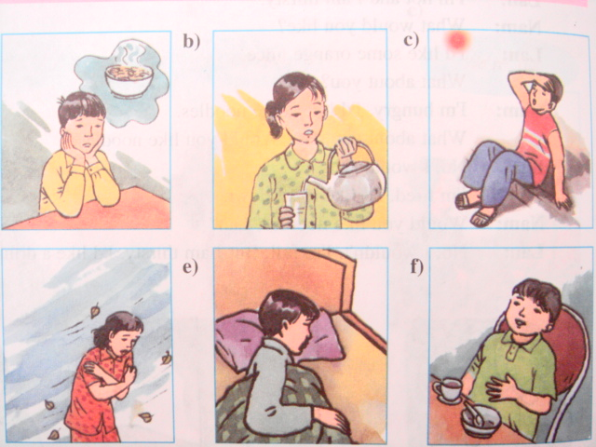
HOW DOES SHE / HE FEEL?
1
2
3
She is thirsty
She is cold
He is tired
4
5
6
He is hungry
He is hot
He is full

Slide 3
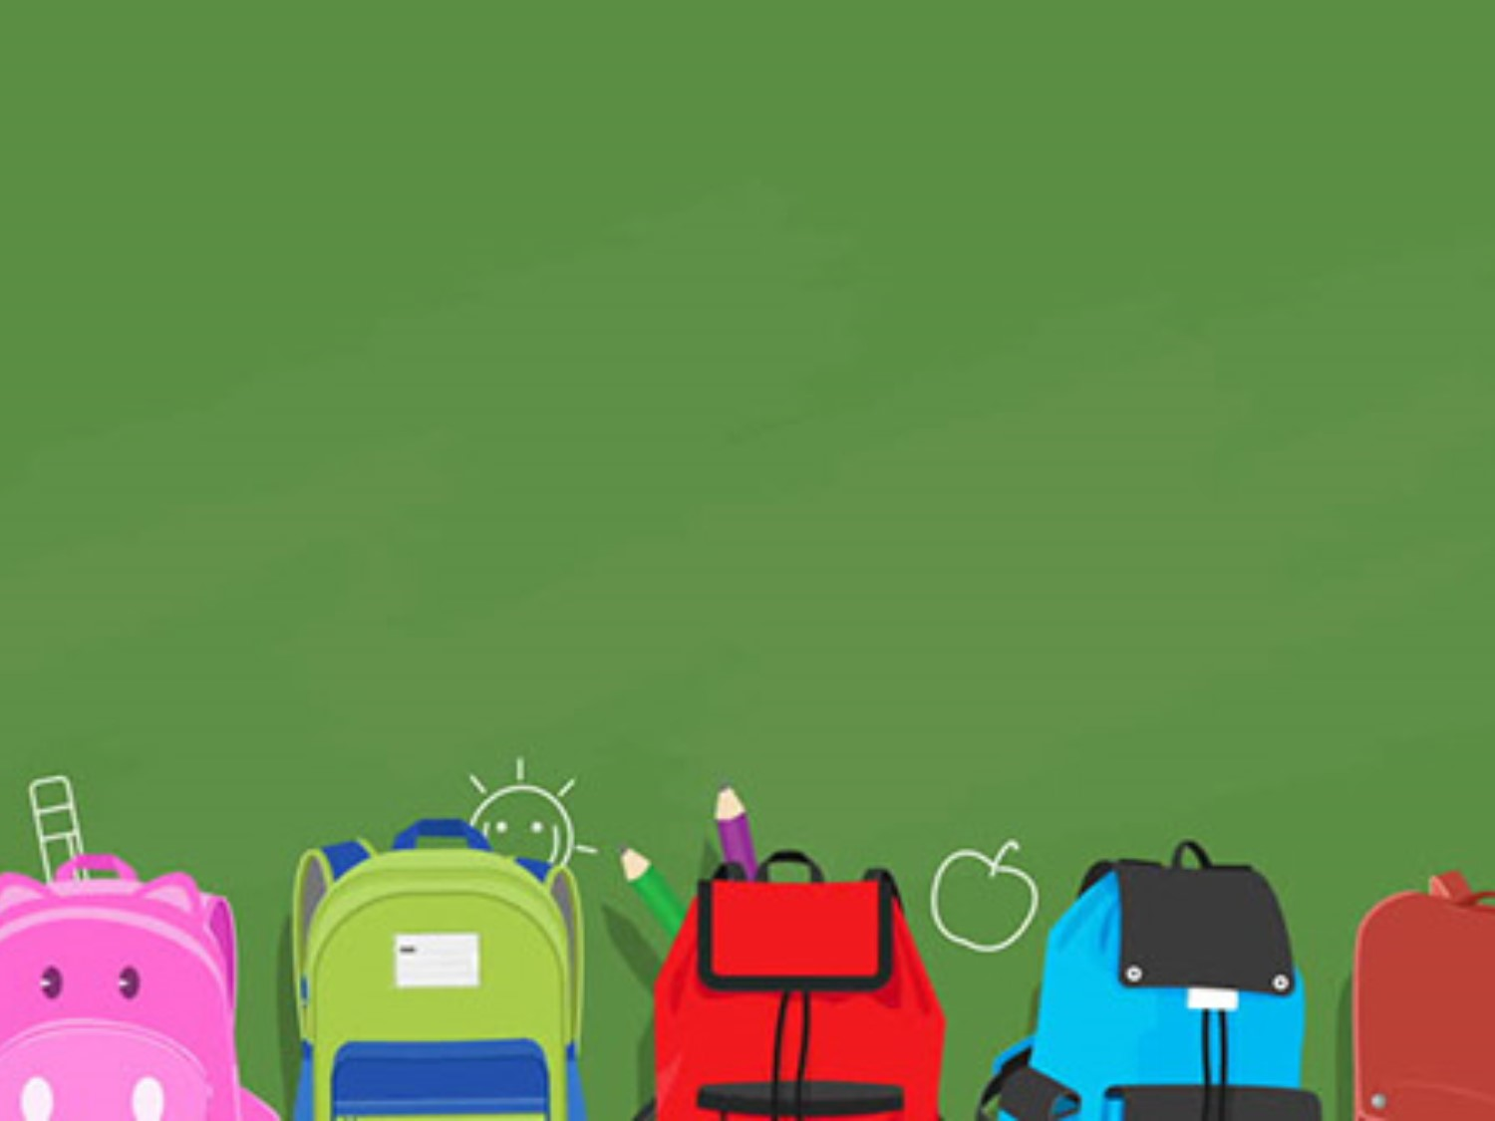
Monday, April 20th , 2020
Unit 10: Staying healthy
B1, 2, 3. Food and drink

Slide 4
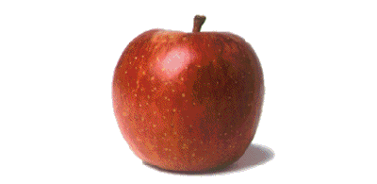
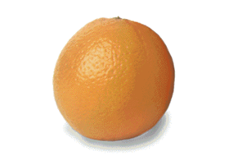
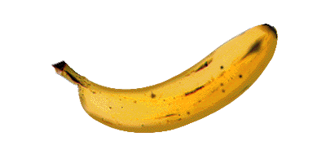
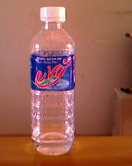

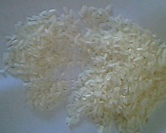
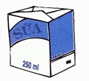
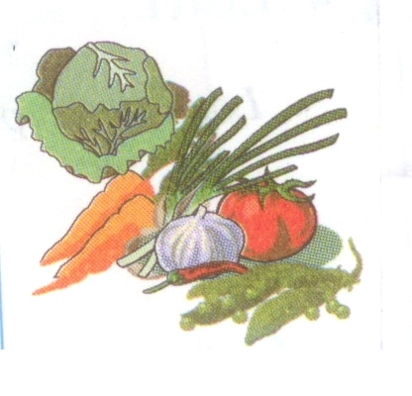
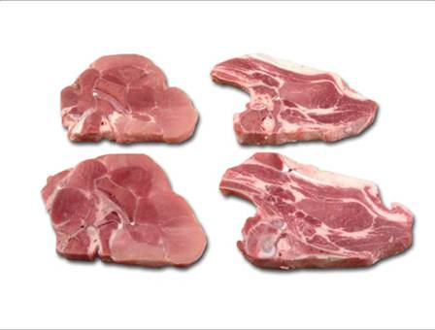
New words:
apple
orange
banana
water
meat
vegetables
rice
milk

Slide 5
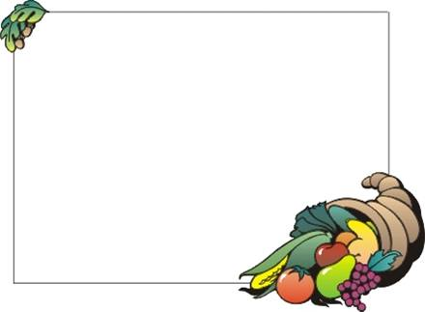
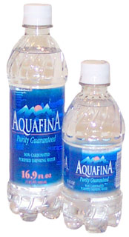
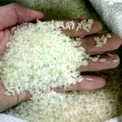
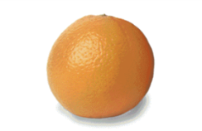
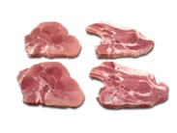
MATCHING:
a.
1. an apple
2. an orange
b.
3. a banana
c.
4. water
d.
5. rice
e.
6. meat
f.

Slide 6
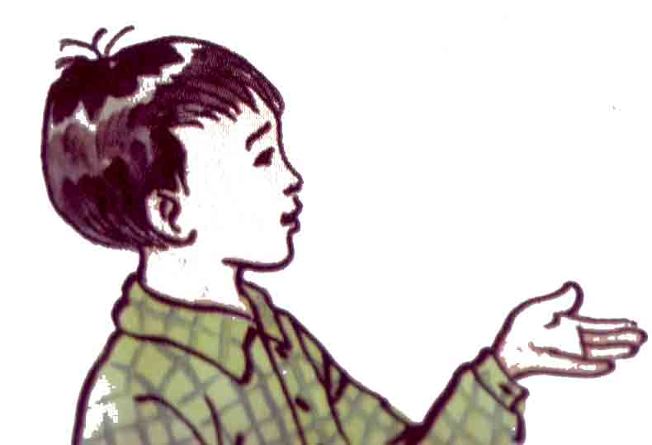
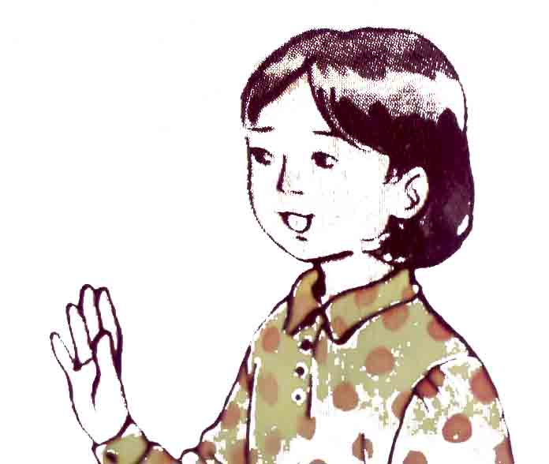
Now practice with a partner:
What would you like?
- I’d like an apple. What would you like?
I’d like some milk
Nam
Mai

Slide 7


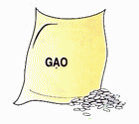

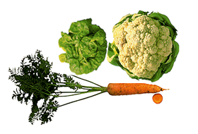
an apple
an orange
a banana
water
rice
milk
meat
vegetables
What would you like?
Practice in pairs:
I’d like a banana.
S1: What would you like?
I’d like some bananas.
S2: I’d like …………...
I’d like some milk.

Slide 8
2. Listen and repeat then practice in pairs.
What do Thu and Phuong have for lunch?:
There is…
What’s for lunch?
Phuong
Thu

Slide 9


* Listen and repeat. Then practice in pairs.
Phuong: What’s for lunch?
Thu : There is some meat and some rice
Phuong: Are there any noodles?
Thu : No, there aren’t any noodles.
Phuong: Is there any fruit?
Thu : Yes, there is some fruit. There are
some oranges and some bananas
Phuong: What’s there to drink?
Thu : There is some water.
Phuong: Is there any milk?
Thu : No, there isn’t any milk.

Slide 10

What do Thu and Phuong have for lunch?:
What’s for lunch? | Yes | No
There is some meat.
There is some rice
There are some noodles
There are some bananas
There are some oranges
There is some water
There is some milk








Slide 11

* Model sentences:
Ex1: Is there any fruit?
+ Yes, there is some fruit./ No, there isn’t any fruit.
Is there + any + uncountable noun
+ Yes, there is some…/ No, there isn’t any…
Ex2: Are there any noodles?
+ No, there aren’t any noodles
+ Yes, there are some noodles.
2. Are there + any + plural noun
+ Yes, there are some…/ No, there aren’t any…
* Some is used in affirmative sentences (+).
* Any is used in negative and interrogative sentences (-), (?).
* Some and any are used with countable plural nouns (apple, orange...) and uncountable nouns (milk, meat...).

Slide 12
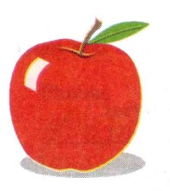
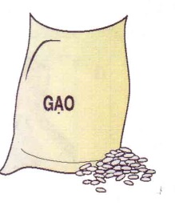

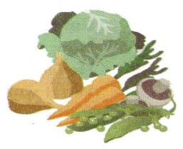
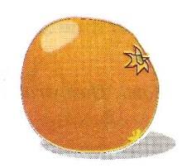
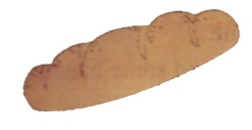
Practice:
2. Make questions and answer:
☑
☒
☑
☑
☒
S1:
Are there any apples?
S2:
Yes, there are some apples
S1:
Is there any rice?
S2:
No. there isn’t any rice
Yes, there is some _____
S1:
…
S2:
…

Slide 13
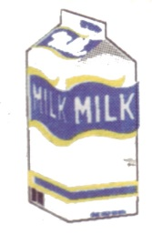
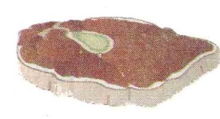
3. Ask and answer:
☑
☒
☑
☑
☒
☒
☑
Yes. There is some ….
Is there any ...?
No. There isn’t any ….
Yes. There are some ….
Are there any...?
No. There aren’t any ….

Slide 14



*Assignments
 Learn the new words and structures.
 Do exercises
 Prepare new lesson: C 1,2,3,4.

Slide 15

Thank you for your attention

